Slide 1
Atomic Energy and the Arms Race
Lecture to HIS 311Y
28 January 2016
Adam Chapnick

Slide 2
Outline
Early History of Atomic Energy in Canada
Canada and Atomic Energy in the 1950s
North American Radar Defence
The Politics of Nuclear Weapons Under Diefenbaker

Slide 3
Early History of Atomic Energy
Background
Atomic Energy and the Second World War
UN Atomic Energy Commission

Slide 4
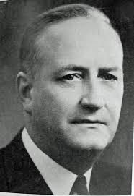
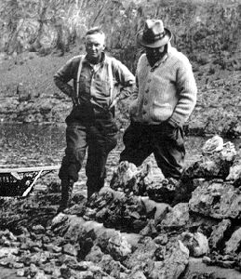
Background
Radium
Gilbert Labine
Eldorado Goldmines Limited

Slide 5
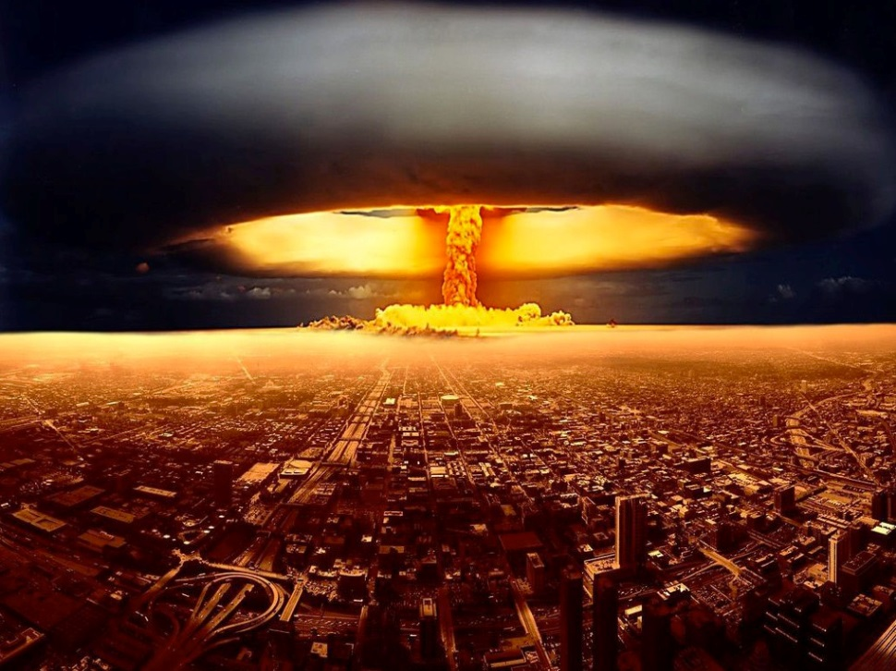
Atomic Energy and WW2
Atomic bomb
Manhattan Project
Hiroshima and Nagasaki (1945)

Slide 6
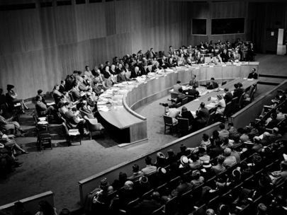
UN Atomic Energy Commission

Slide 7
Canada and Atomic Energy in the 1950s
Relations with India
Industrial Developments

Slide 8
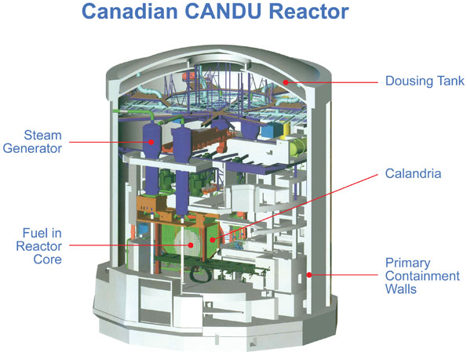
Relations with India
NRX
CANDU reactor
India’s atomic test 1974

Slide 9
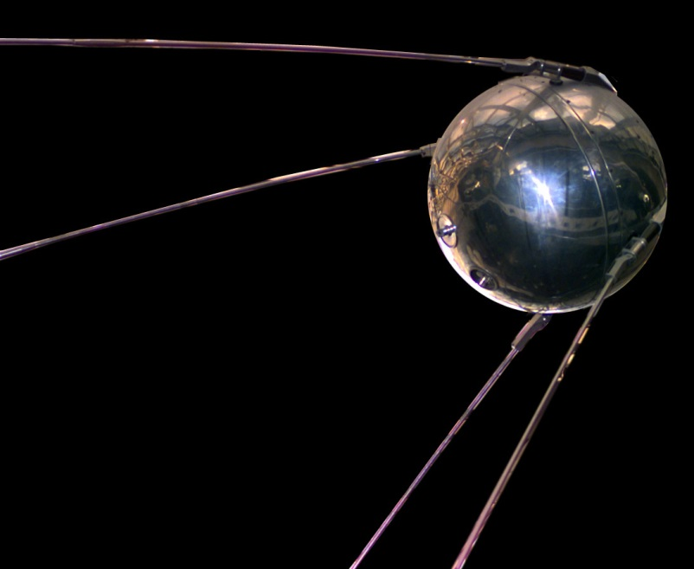
Industrial Developments
Hydrogen bomb
Tactical nuclear weapons
Sputnik (1957)
Massive retaliation

Slide 10
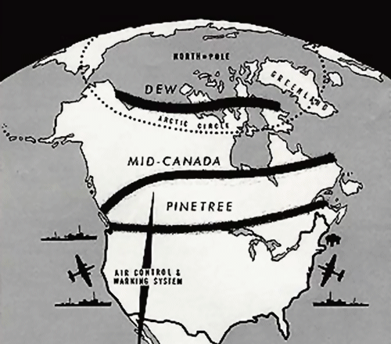
North American Radar Defence (one slide)
Context
Radar Lines
Implications

Slide 11
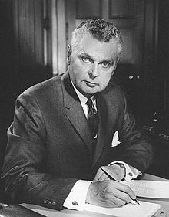
The Politics of Nuclear Weapons Under Diefenbaker
The Majority Era, 1958-62
The Minority Era, 1962-63
The American Intervention

Slide 12
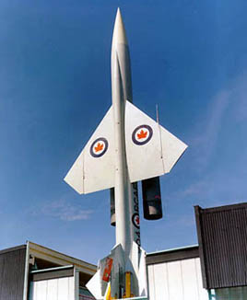
The Majority Era
BOMARC
Norman Robertson (deputy minister); Howard Green (foreign minister)
Douglas Harkness (defence minister)

Slide 13
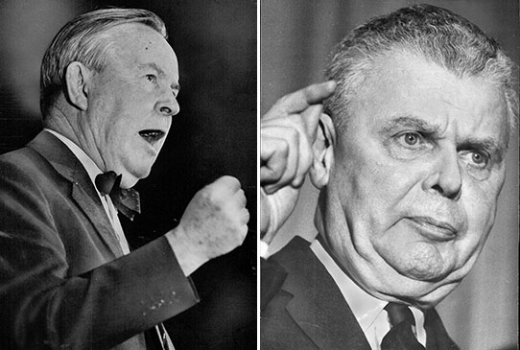
The Minority Era

Slide 14

The American Intervention

Slide 15
Summary and Conclusions
Atomic energy development
UN Atomic Energy Commission
Relations with India
North American radar defence
Diefenbaker

Slide 16
Questions?
chapnick@cfc.dnd.ca
@achapnick
http://adamchapnick.ca

