Slide 1
Energy & Foreign Policy, 1968-1984
TA Jennifer
jennifer.bonder@utoronto.ca
March 8, 2016

Slide 2




Trudeau period, 1968-1984
Elections
1968 | Trudeau MAJORITY | Mitchell Sharp Allan MacEachen Don Jamieson | Lyndon Johnson Richard Nixon Gerald Ford Jimmy Carter Ronald Reagan
1972 | Trudeau minority
1974 | Trudeau MAJORITY
1979 | Clark minority | Flora MacDonald
1980 | Trudeau MAJORITY | Mark MacGuigan Allan MacEachen
1984 | Mulroney MAJORITY | Joe Clark

Slide 3
Trudeau’s energy policy is about a lot of things other than oil.

Slide 4
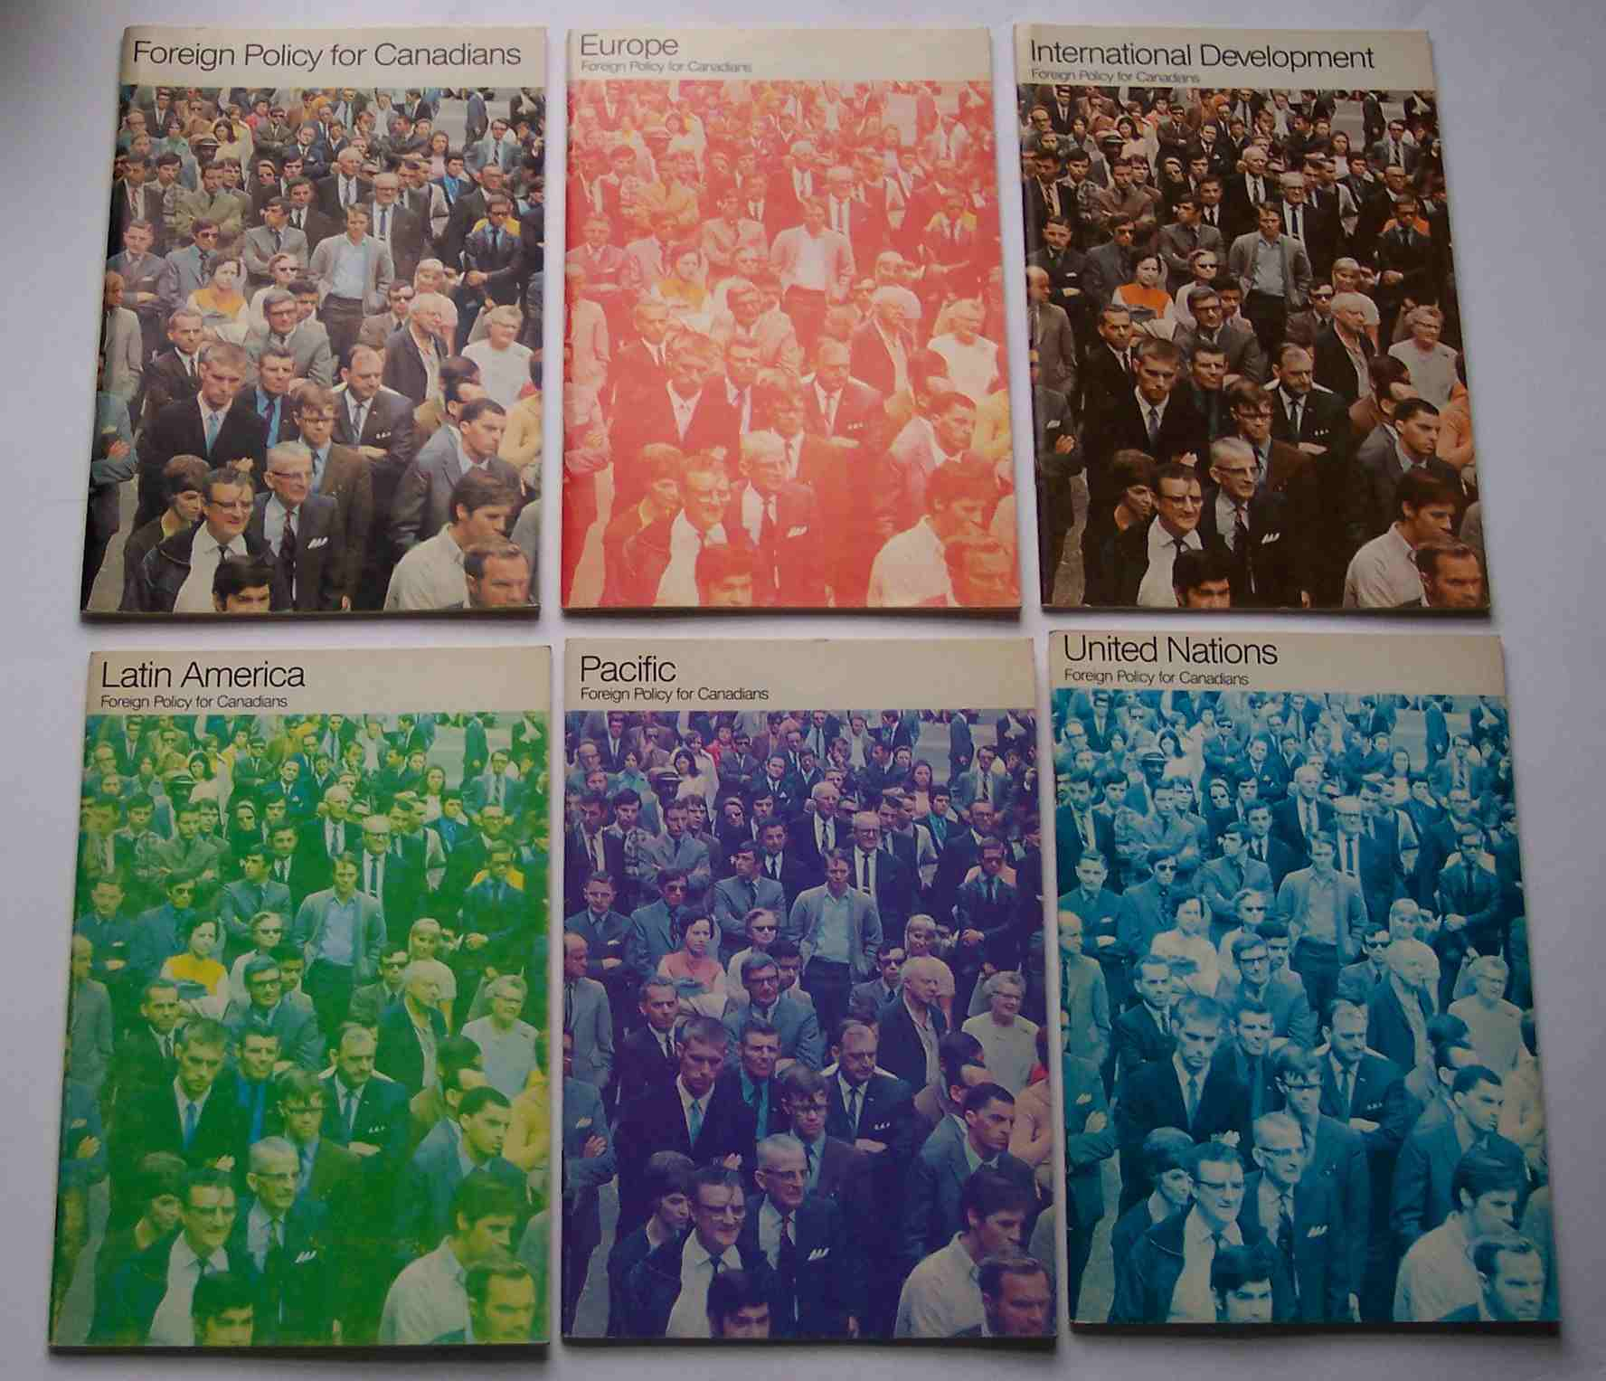
Context
Cold War decompression
Federal budgets
Foreign policy review

Slide 5
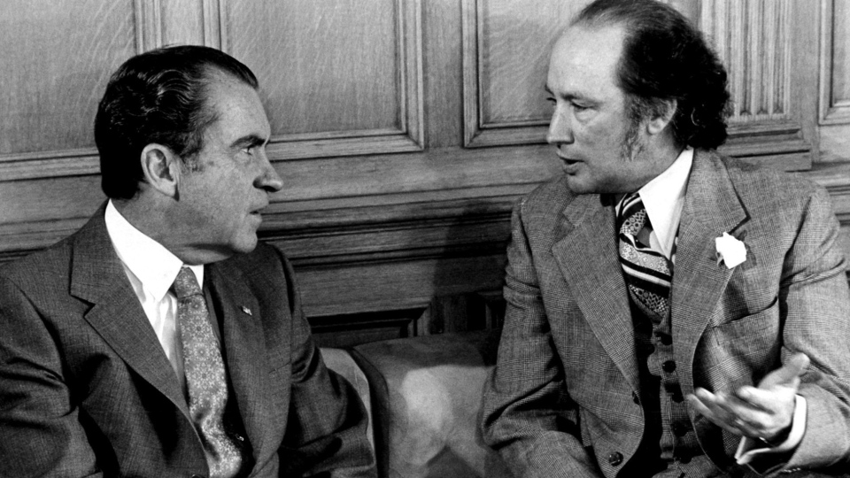
Trudeau & the Americans

Slide 6
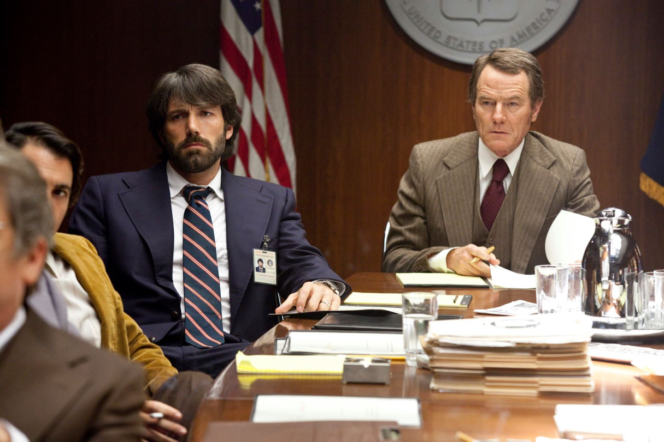
Oil
Seven Sisters
OPEC
Club of Rome
Yom Kippur War
International Energy Agency (IEA)
Iranian Revolution
‘stagflation’

Slide 7
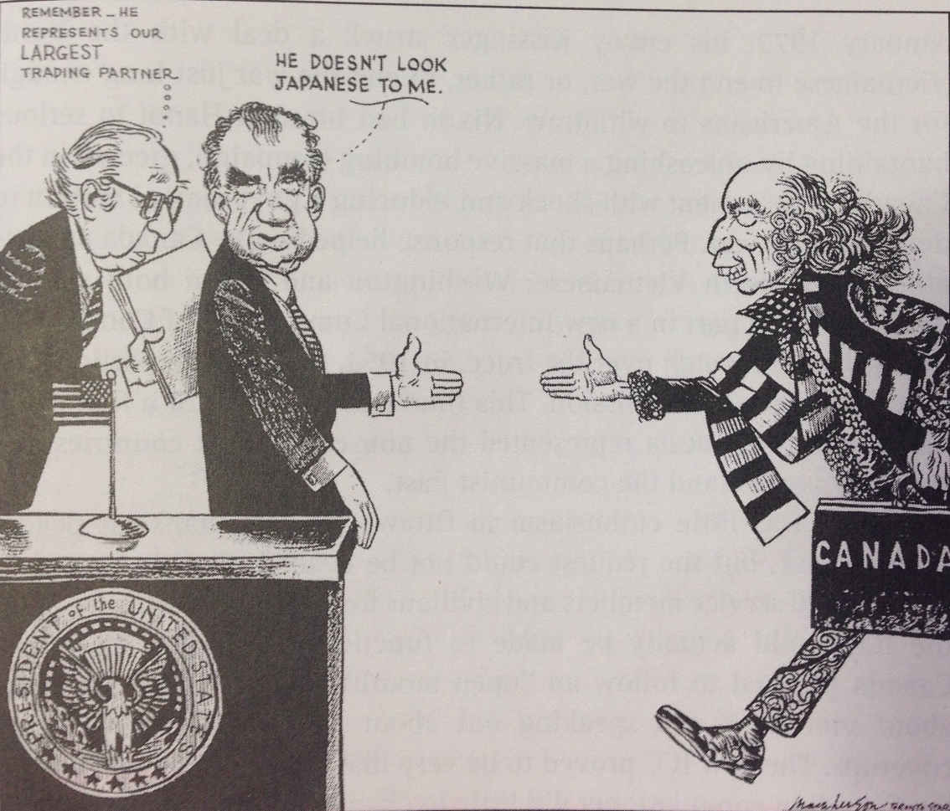
American response
Canadian response
Nixon’s “Shokku”
The Third Option

Slide 8
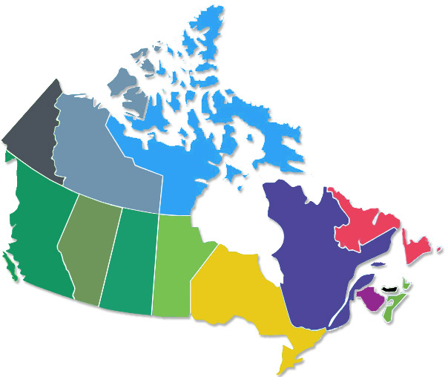
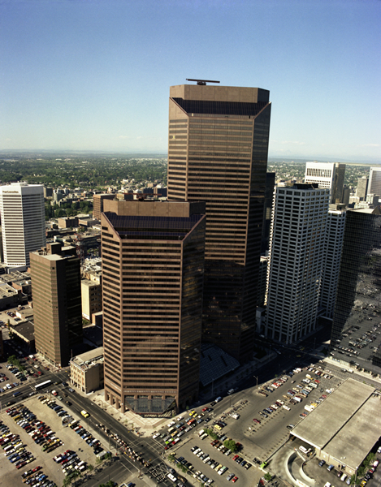
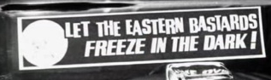
Canada Development Corporation
Foreign Investment Review Agency
Petro Canada
National Energy Program

