Slide 1
HIS311 WORKSHOP :: 2015
Some tips for...
Research & Writing
in History/IR
by Tina J. Park

Slide 2
AGENDA FOR TODAY:
What is History?
Research paper as a “genre” of writing
History vs Poli-sci: Your discourse community
Enter U of T: the overwhelming expectations
Some common problems
Why bother? the perks of being a good writer...
Tina’s top ten tips
Intro, Body, Conclusion
Intertextuality & Chicago Style of Citation
A checklist before submission
Editing strategies & resources
How am I being graded?
Final words of advice
Q&A &Contact info

Slide 3
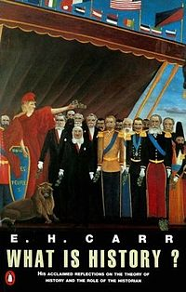
What is History?

Slide 4
What is History?
19th century empirical approach
E.H. Carr - historians arbitrarily determine which of the "facts of the past" to turn into "historical facts" according to their own biases and agendas
A relationship "of equality, of give-and-take" between the historian & their evidence.
A meeting of characters and circumstances
*** History is ” a continuous process of interaction between the historian and his facts, an unending dialogue between the past and the present.” -Carr

Slide 5
Research paper as a “genre”
“Genre” in writing:
“A genre comprises a class of communicative events, the members of which share some set of communicative purposes. These purposes are recognized by the expert members of the parent discourse community and thereby constitute the rationale for the genre. This rationale shapes the schematic structure of the discourse and influences and constrains choice of content and style. Communicative purpose is a criterion…that operates to keep the scope of a genre narrowly focused on comparable rhetorical action. In addition to purpose, examplars of a genre exhibit various patterns of similarity in terms of structure, style, content and intended audiences. If all high probability expectations are realized, the examplar will be viewed as prototypical by the parent discourse community.”*
* John Swales, Genre Analysis, (Cambridge: Cambridge University Press, 1990), 58.

Slide 6
Writing for your discourse community
Political science vs history
Historians conceive and explain historical change primarily or ultimately in terms of human conduct, that is, purposive acts of agency, not behaviour. (check Paul Schroeder)
IR theory & approach to explanation
Notes:
Although recognizing that human life is powerfully limited, conditioned, shaped and driven by external, nonhuman factors, historians would nonetheless insist that the story of diachronic change as history rather than biology or something else centers on human conduct in response to these factors.
i.e. The Black Death is explained by biological factors; the history of the Black Death is the history of human responses and societal changes involved in it.
It is in how historians typically try to explain historical change and the kind of “explanation” sought that the difference between history and social science most often becomes apparent. The standard social science approach calls for the formulation of an initial hypothesis, examination of relevant theory, exposition and defense of a research strategy, testing of the hypothesis, leading to a conclusion confirming, disproving, or revising the initial hypothesis as a step toward better theory and sounder generalizations. Instead of this, the historian would often start by perceiving a problem – a historical phenomenon ignored, left unexplained, or apparently analyzed and accounted for inadequately or wrongly. The procedure for addressing the problem, distressingly vague by social science standards, is to constitute a limited universe of inquiry by defining the historical development to be studied, determining what kinds of evidence would shed light on it, marshalling all the available relevant evidence possible and trying to develop a new, better synoptic judgment or interpretation of the phenomenon on the basis of that evidence.
IR theory would seem to present no fundamental challenge to the assumptions and goals of historical explanation, and therefore offer no obstacle in principle to cooperation between two disciplines. Political scientists may want to insist on different methods, aim for a different kind of testing of hypotheses and seek a different kind of outcome than the historian’s synoptic judgments. Nonetheless, as long as neither side denies in principle the possibility and validity of the other’s general approach to explanation, or rejects in principle its truth claims, there is room for a good fit between them and valuable collaboration or mutual borrowing.

Slide 7

Enter U of T...
Where do I start ?!?!
How early should I start researching?
How do I do university-level research?
What am I being evaluated on?
How do I selectively choose fact?
What makes a good thesis? an A-level essay?
When do I move from research to writing?
How do I edit my own work?

Slide 8
some common problems found:
Poor time management
Lack of depth and scope in research
Weak thesis & supporting arguments
Paragraph & sentence structures
Poor grammar and writing style
Lack of creativity & logical flow
Ultimately, lack of effort, time, enjoyment
= low grade

Slide 9
Why writing skills matter...
Your GPA follows your life
Primary means of evaluation & the main channel of interaction with your TAs/Prof (read: reference letters)
$$$ incentive (merit-based scholarships)
Extra-curriculars, internships and jobs
One practical skill out of you undergrad = learning to read and write critically!

Slide 10

So, where do I start...?

Slide 11
My top 10 Tips

Slide 12

1. Create your #GamePlan!
Preliminary research by ______________
Annotated bibliography by ____________
Note-taking by ______________
Rough draft by ______________
Editorial process by ___________
Final draft by ______________
**KEY: YOUR OWN DEADLINES

Slide 13

2. Brainstorm!
Library catalogue: advanced search
Browsing the shelves /ask for help@ libraries
Bibliographies of existing sources
Google scholars/online keyword searches
JSTOR, Scopus, and other article databases
Book reviews & Historiographical essays
Dissertation database (non-U of T accessible)
Newspaper archives & Factiva!
**keep track of your sources (ie annt’d bib)

Slide 14
Some things to remember:
Not all books/articles are equally important
Read books to find more books
Have a rating system that works for you
Always look up who wrote the source/when
Keep track of your own bibliography (excel/zotero/refworks etc)
Always categorize sources by your thesis/key arguments (ie color coding, numbering, etc)
A research binder might be helpful ☺

Slide 15
3. Put on your historian’s hat!
Look up the author’s credentials
Quality of Research & publisher/funding source
Historiography & where it stands in the scholarship (note the year of publication)
Structure, scope and main themes
Thesis & key arguments – are you persuaded?
Analytical framework, assumptions, implications & overall usefulness for your work
CRITICAL THINKING GETS BETTER w/ PRACTICE

Slide 16
4. ROLL OUT AN OUTLINE!
*THESIS*
INTRO
Argument (1)
Argument (2)
Argument (3)
Argument (4)
Argument (5)
CONCLUSION

Slide 17
#Outlining Made Easy
DIRECTLY ANSWER THE QN!
AIM FOR A STRONG + CLEAR THESIS
ALWAYS RETURN TO THE THESIS
AIM FOR A LOGICAL FLOW
KEEP IT SIMPLE
WRITE FOR CLARITY
SAVE YOUR BEST FOR THE LAST
KEEP REVISING AS YOU GO

Slide 18
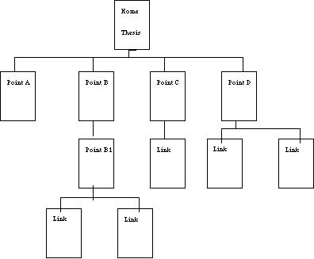

Slide 19
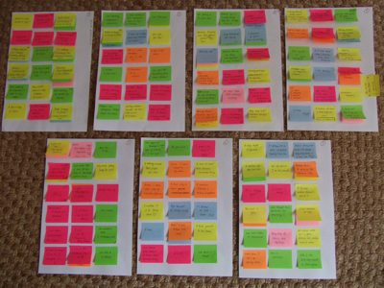

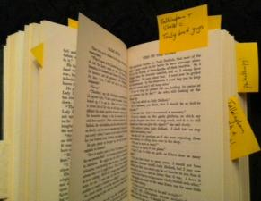
5. GO THROUGH SOURCES &
MARK ANY USEFUL
FACTS/ARGUMENTS!

Slide 20
6. My secret: research binders
Time & Resources = limited
Centralize all your research materials
Photocopy parts of books you find useful (don’t forget to copy the cover page & back)
Collect articles, news, statements, primary materials, in-course instructions, tips from your professor, comments from the TA, etc.
Categorize & highlight as you see fit

Slide 21
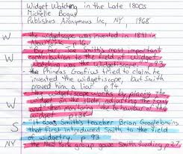
7. GET YOUR RESEARCH SORTED!
Timeline
Arguments
Figures
Ideas
Comparison
FOCUS ON the
ANALYTICAL
VALUE!

Slide 22
8.Tackling your blank screen: 1st draft
Review your research notes to this date
Type up or organize the notes by argument/theme/document file
Go back to your outline & assess if you still want to go ahead with the Plan A
Carefully citing the source of your notes, stop staring and start typing!
Always remember your first draft is bound to change!
Dedicate a set time/place for this process. You’ll need to stay focused at all times

Slide 23

9. SPEAK TO YOUR AUDIENCE
Historical narrative matters
Chronology/fact matters
Depth of analysis matters
Avoid jargons at all cost
Don’t write a poli-sci paper for a history course
Try to understand where your paper fits in your course/scholarship
Notes:
Although recognizing that human life is powerfully limited, conditioned, shaped and driven by external, nonhuman factors, historians would nonetheless insist that the story of diachronic change as history rather than biology or something else centers on human conduct in response to these factors.
i.e. The Black Death is explained by biological factors; the history of the Black Death is the history of human responses and societal changes involved in it.
It is in how historians typically try to explain historical change and the kind of “explanation” sought that the difference between history and social science most often becomes apparent. The standard social science approach calls for the formulation of an initial hypothesis, examination of relevant theory, exposition and defense of a research strategy, testing of the hypothesis, leading to a conclusion confirming, disproving, or revising the initial hypothesis as a step toward better theory and sounder generalizations. Instead of this, the historian would often start by perceiving a problem – a historical phenomenon ignored, left unexplained, or apparently analyzed and accounted for inadequately or wrongly. The procedure for addressing the problem, distressingly vague by social science standards, is to constitute a limited universe of inquiry by defining the historical development to be studied, determining what kinds of evidence would shed light on it, marshalling all the available relevant evidence possible and trying to develop a new, better synoptic judgment2 or interpretation of the phenomenon on the basis of that evidence.
IR theory would seem to present no fundamental challenge to the assumptions and goals of historical explanation, and therefore offer no obstacle in principle to cooperation between two disciplines. Political scientists may want to insist on different methods, aim for a different kind of testing of hypotheses and seek a different kind of outcome than the historian’s synoptic judgments. Nonetheless, as long as neither side denies in principle the possibility and validity of the other’s general approach to explanation, or rejects in principle its truth claims, there is room for a good fit between them and valuable collaboration or mutual borrowing.

Slide 24
10. TREAT YOURSELF WELL ☺
Be disciplined with your everyday schedule
Block out social media when you study!
Find trustworthy study buddies!
Set aside time to exercise every day! Physical work out will boost your productivity!
Eat well – go for protein/veggies over fat/carb
Do something fun every week/reward yourself
If your plans fail, remember to bounce back w/ Plan B. Enjoy the ride. ☺

Slide 25
THE ABCs of your essay
INTRO
BODY
CONCLUSION

Slide 26
#INTRO: YOUR FIRST IMPRESSION!
SET UP your research space
Historical Context to the research question
Something about the historiography
Your thesis & why this research matters (ie it challenges existing interpretations, seeks to fill a gap in research, etc)
Overview of arguments
Roadmap of the paper
** BE AS CONCISE AND CLEAR AS POSSIBLE

Slide 27
ADVANCED:YOUR RESEARCH SPACE
#1Establishing a territory
Claiming centrality
Making topic generalizations
Reviewing items of previous research
#2 Establishing a niche
Counter-claiming
Indicating a gap
Raising a question
Continuing a tradition
#3Occupying the niche
Outlining purposes
Announcing present research
Announcing principal findings
Indicating the research structure

Slide 28
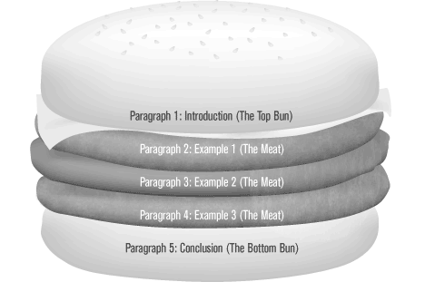
#Body: TIME TO SHINE.
1) Claim
2) Grounds
3) Warrants
4) Backings
5) Qualifiers
6) Rebuttal
Notes:
1) Claim: assertion the arguer wishes the audience to accept
2) Grounds: basis of real persuasion – the truth on which the claim is based (particular facts in the situation that make good the claim, ie experimental observations, statistical data, common knowledge, personal testimony)
3) Warrants: previously agreed upon facts, rules, laws, principles, statutes, formula (authorize the movement from grounds to claims, legitimizes the claim by showing the grounds to be relevant)
4) Backings: body of generalizations relied on to establish the soundness and relevance of the warrants
5) Qualifiers: indicates the strength of the movement from the data to the warrant (may limit the universality of the claim – “hedging”; may strengthen the claim – “always” or “never”)
6) Rebuttal: acknowledges that counter-arguments exist (any rebuttal is an argument in itself, and thus may include a claim, warrant, backing, etc.)

Slide 29
What TO WATCH OUT FOR (BODY)
Topic sentence of each paragraph should relate DIRECTLY to your thesis
Be careful how you structure your arguments
Logical flow depends a lot on transitions
Avoid generalization, exaggeration, repetition
Be judicious in what you say and how you say it
Practice being concise. Do not ramble!
Learn from leading scholars in your field
BACK UP everything you say – be ready to be accountable for every word you use

Slide 30

#Conclusion: FINAL PUNCH
The role: to recap what the body of your paper discussed in the most succinct and effective way!
Implications of the argument, summary of points, or a final evocative thought...

Slide 31
# Intertextuality & levels of citation
not just a matter of which other texts you refer to, but how you use them, what you use them for, and ultimately how you position yourself as a writer to them to make your own statement.
  Levels of citation
  1) Block quotation
  2) Direct quotation
  3) Integrated quotation (paraphrasing/generalization)
Notes:
Rules about Quotations:
Only quote directly from a secondary source when the actual words of the author and not the ideas are crucial to your point – otherwise paraphrase and footnote.
Do not use a direct quote when you can paraphrase just as well
Any direct quotations from a secondary source must appear in quotation marks as well as be properly cited. WARNING: To quote verbatim from a text without using quotations or citing is plagiarism; you may quote primary sources more liberally but follow the same rule regarding quoting and citing
Quotations should NOT repeat something you have just written
Be sure to give your quotations context: identify the speaker (if there is one) and be sure to explain its significance. Rarely should quotations end paragraphs
Quotations should not stand alone in essays (should not be their own sentences) Instead, introduce your quotations and integrate them into your sentence. This integration must not sacrifice the sentences grammatical validity. At times, there will be no punctuations between your introduction and your quotation. At times, a comma will suffice. In the case of a full stop , use a colon
Indent long quotations

Slide 32
#CHICAGO STYLE!
http://www.chicagomanualofstyle.org/tools_citationguide.html
FOOTNOTE
1. Michael Pollan, The Omnivore’s Dilemma: A Natural History of Four Meals (New York: Penguin, 2006), 99–100.
BIBLIOGRAPHY (alphabetical)
Pollan, Michael. The Omnivore’s Dilemma: A Natural History of Four Meals, New York: Penguin, 2006.

Slide 33
A CHECKLIST BEFORE SUBMISSION
A title page with a relevant title, course code, your name, student number, TA’s name, date
Essay, Bibliography, Academic integrity page
Adhere to margins, fonts, citation style enforced in the course (go back to the course syllabus!)
Do I have a strong and coherent thesis?
Does the topic sentence of each of my paragraph relate back to my thesis?
Have I used enough facts/evidence to back up ideas?
Does my research paper stay analytical throughout?
Have I correctly cited everything that did not originate from my own brain?
Is it easy to read? Do I relate back to the course?

Slide 34


Editing strategies
& Available resources
REVERSE OUTLINING
Self-editing & Peer-editing
U of T (college-based) writing centres
Teaching assistants & dons at colleges
Go over the course syllabus before submission

Slide 35

HOW AM I BEING GRADED? (HIS-focused)
Analytical strength &
coherence of arguments
Quality and depth of research (primary and secondary)
Judiciousness of writing (clear, succinct, engaging, tight prose…etc)
Contribution to the scholarship (bonus!)
Grammar & style
Overall impression

Slide 36
Final words of advice
Enjoy the process! It is a privilege to be able to share your ideas with intellectual peers and to be awarded with grades.
Plan diligently and start early. Use your time carefully and stick to your own deadlines!
Be inspired by the leading scholars! READ UP.
Hard work always pays off with GPA. Engage with your intellectual self every day, at a set time and set place, in a disciplined manner!
Ask for advice from your mentors! Bug profs/ TAs during their office hours. They’ll always be happy to see you if you come prepared.

Slide 37

Questions?
FEEL FREE TO CONTACT ME!
Tina Jiwon Park
@jiwontina
E-mail: Tina.Park@utoronto.ca
www.tinapark.ca

